Slide 1
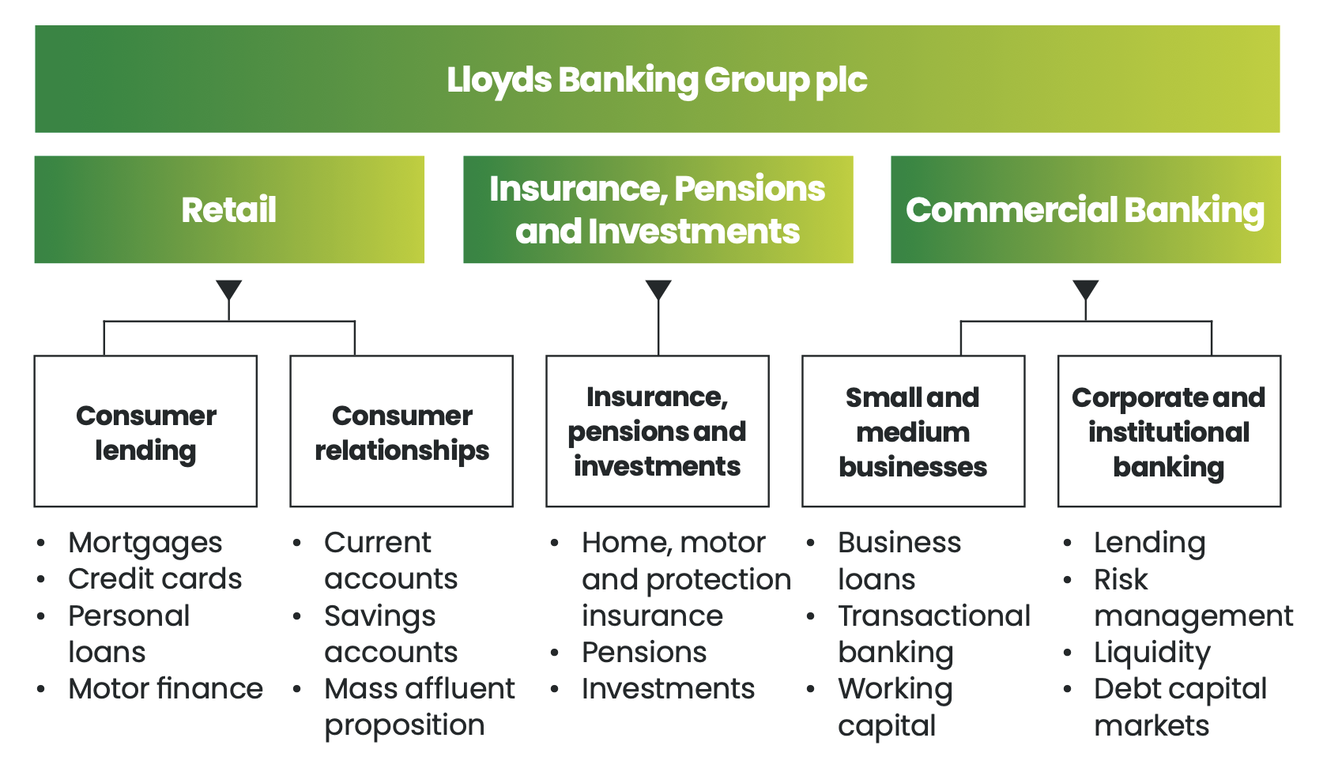
Lloyds
Notes:
We have three core divisions and, in line with our new strategy launched in 2022, we have restructured our business to optimise synergies
and efficiencies to best serve our customers’ needs.

Slide 2
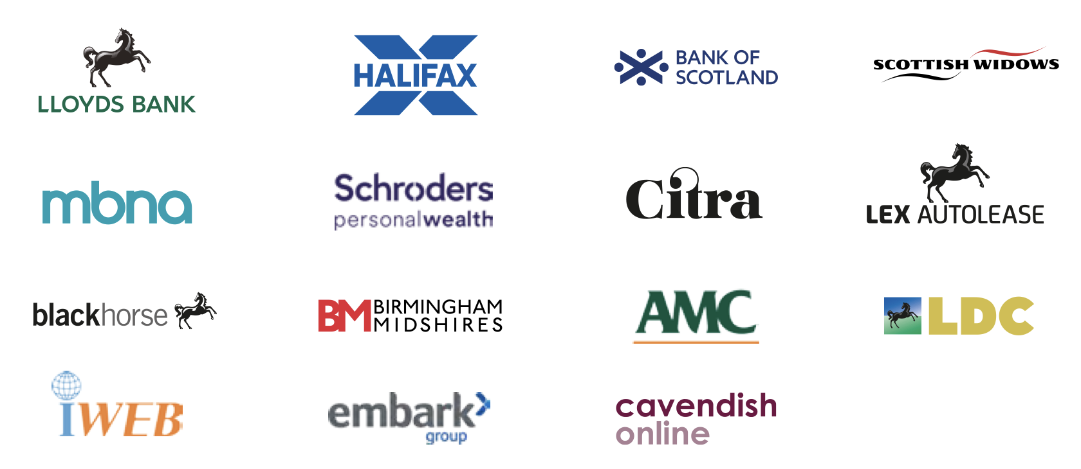





Schroders Personal Wealth is a financial advice firm backed by UK banking giant Lloyds Banking Group
and leading investment manager Schroders. Schroders Personal Wealth offers holistic,
financial planning services to UK customers on a restricted advice basis.
Part of Lloyds Banking Group, Embark is an investment platform and retirement solutions provider supporting financial
advisers and businesses in the UK.
Cavendish Online is an online investment platform and financial advisory service.
Lex Autolease is vehicle leasing company providing fleet management and vehicle leasing solutions.
LDC: Lloyds Development Capital, the private equity arm of Lloyds Banking Group,
specializing in supporting management buyouts, equity release, and growth capital for UK-based companies.
Notes:
Our trusted brands
Our products and services are made available to our customers through our trusted brands, which enables us to address the needs of different customer segments more effectively.

